Slide 1
Space & time trade off

Slide 2
Introduction
An algorithm is a finite step by step list of well defined instructions for solving a particular problem.
Complexity of algorithm
It’s the function which gives the running time or space in terms of input size
Space complexity
Time complexity

Slide 3
Time Complexity
The time complexity of a program or algorithm is the amount of computational time it needs to completion.
It can be expressed as a function of number of key operations performed.
1,logn, n,nlogn,n^2,n^3,n! (fast to slow- low to high complexity)

Slide 4
Space Complexity
The space complexity of a program is the amount of memory that it needs to run to completion.
The space is measured by counting the maximum memory needed by the algorithm in terms of variables used by algorithm.

Slide 5
Three Cases of an Algorithm
Worst case – It is the function which defines the maximum number of steps taken for a data of size ‘n’
Average case
Best case

Slide 6
Time Space Trade Off
It is a situation where the program execution time can be reduced at the cost of more memory or vice versa.
Memory can be reduced at the cost of a slower program
Storage space can save calculation time. Tables can have common functional evaluations to reduce recursive calls.
Another technique is to store preprocess calculations in an array to be used during the final calculations, this is called input enhancement.

Slide 7
Horspool's Algorithm
The brute force string matching problem, a pattern P[0...m-1] is searched for in a text T[0...n-1].
The brute force algorithm in worst case makes m(n-m+1) comparisons, so the cost is Θ(nm). But on average only a few comparisons are made before shifting the pattern, so the cost is Θ(n).

Slide 8
Horspool's algorithm shifts the pattern by looking up shift value in the character of the text aligned with the last character of the pattern in table made during the initialization of the algorithm.
The pattern is check with the text from right to left and progresses left to right through the text.
If the pattern does not match, we shift the pattern towards right, as large as possible.
How much we will shift towards the right depends on the last character of text which is aligned with last character of pattern.

Slide 9
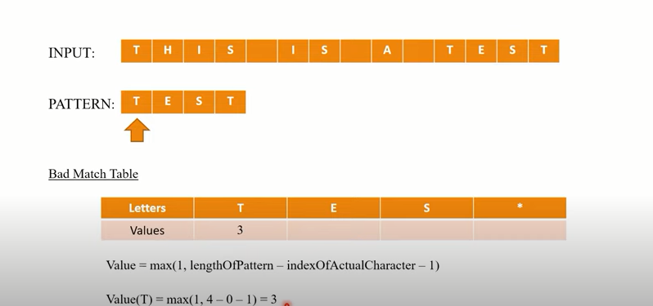

Slide 10
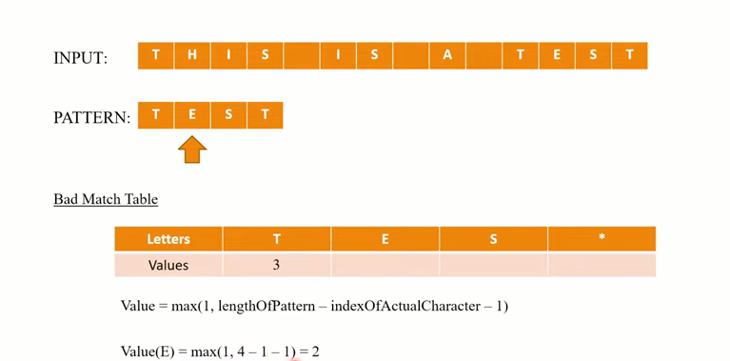

Slide 11
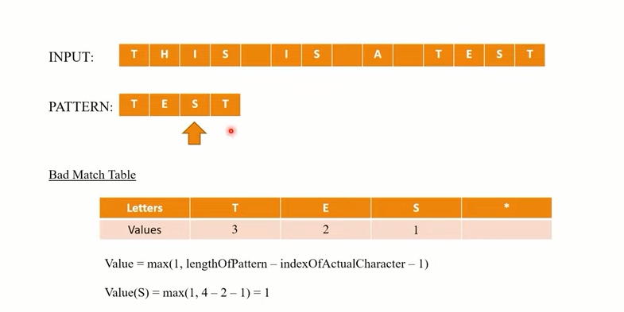

Slide 12
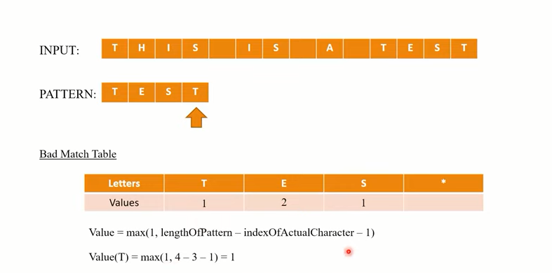

Slide 13
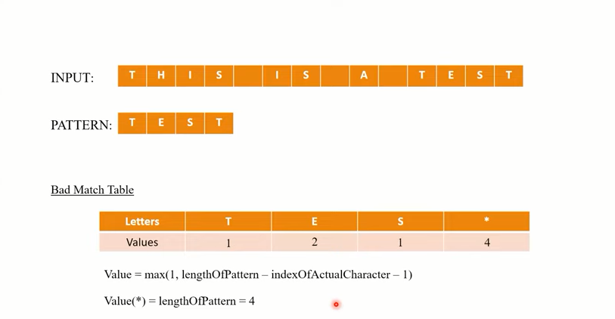

Slide 14
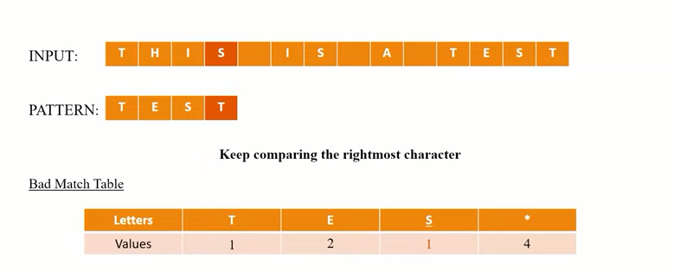

Slide 15
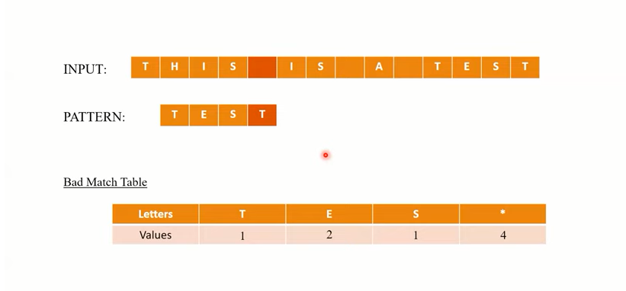

Slide 16
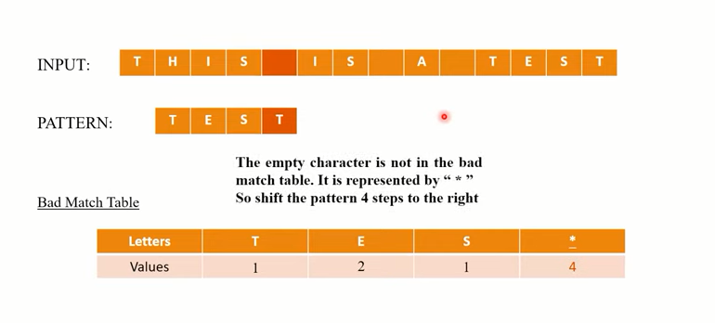

Slide 17
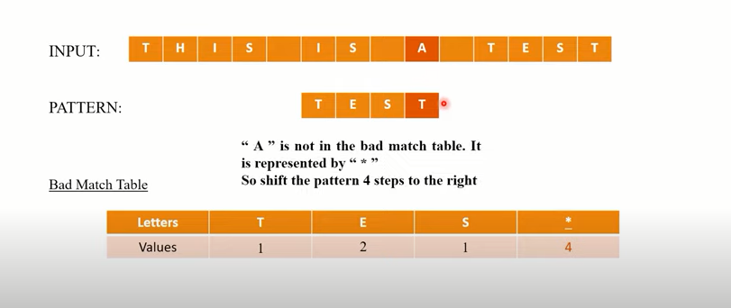

Slide 18
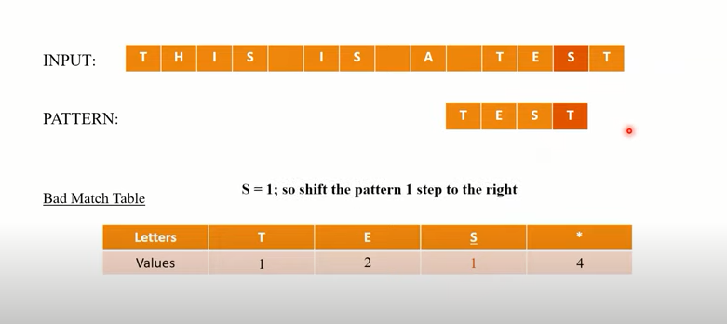

Slide 19
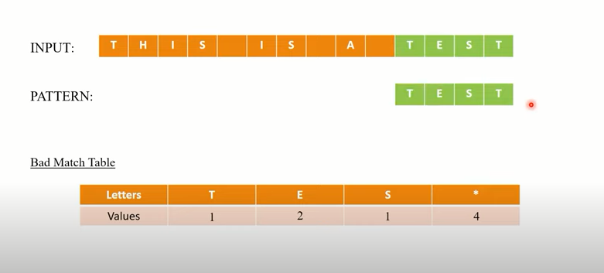

Slide 20
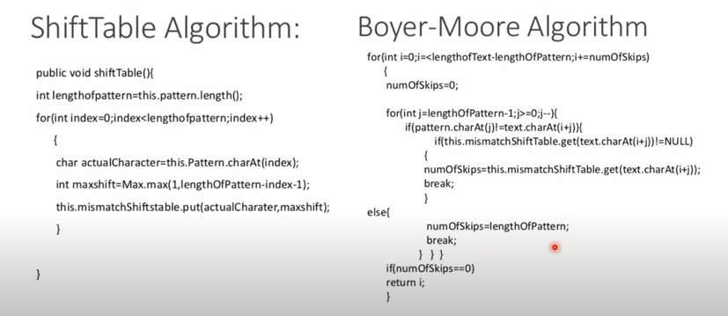

Slide 21
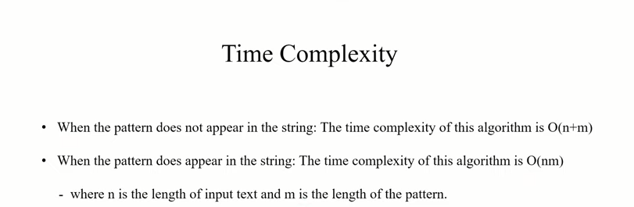

Slide 22
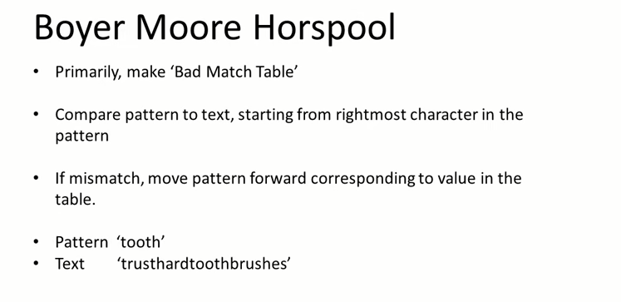

Slide 23
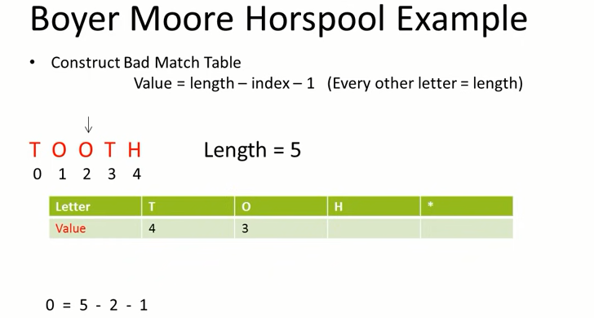

Slide 24
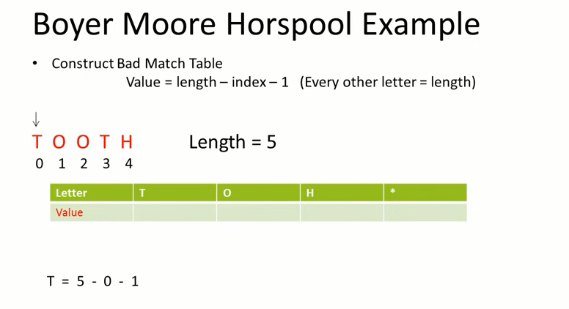

Slide 25
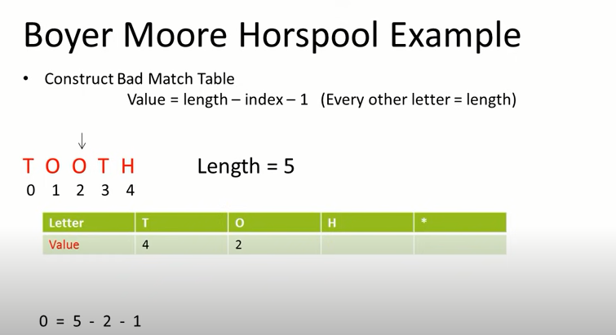

Slide 26
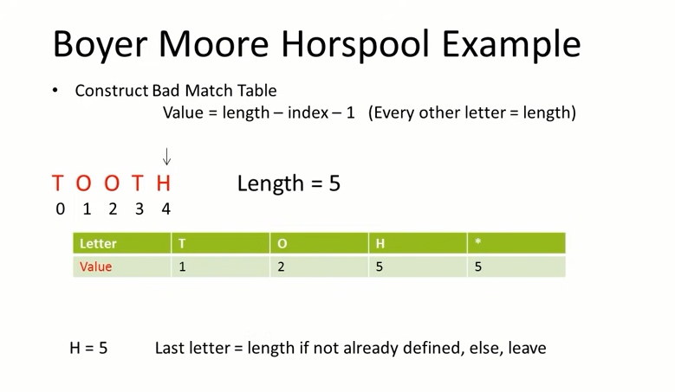

Slide 27
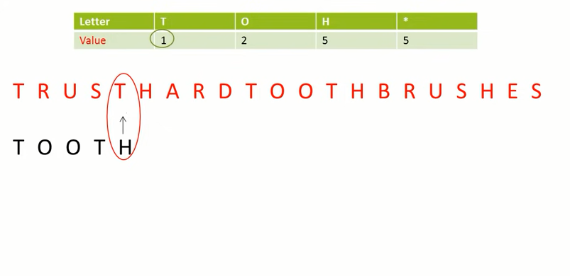

Slide 28
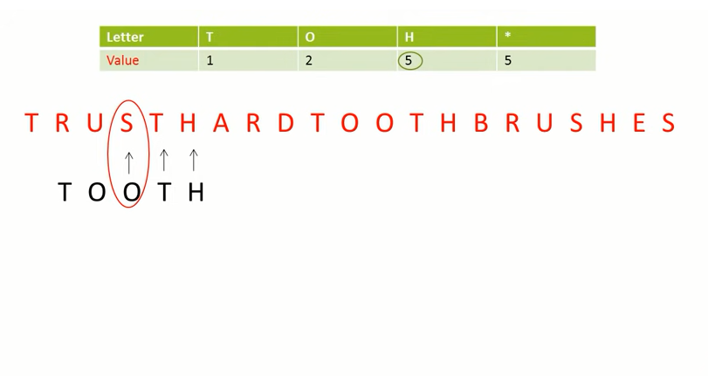

Slide 29
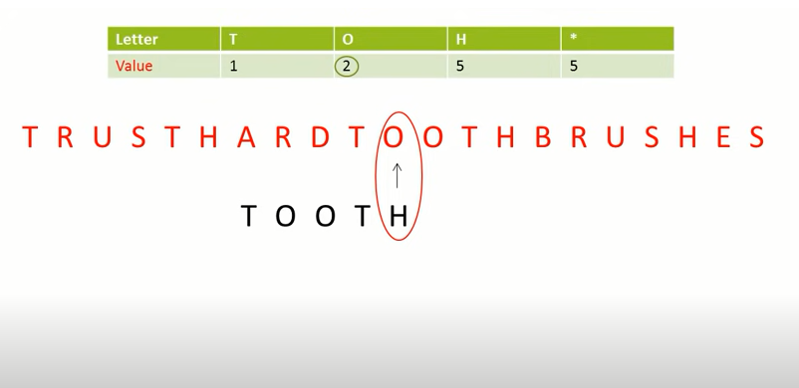

Slide 30
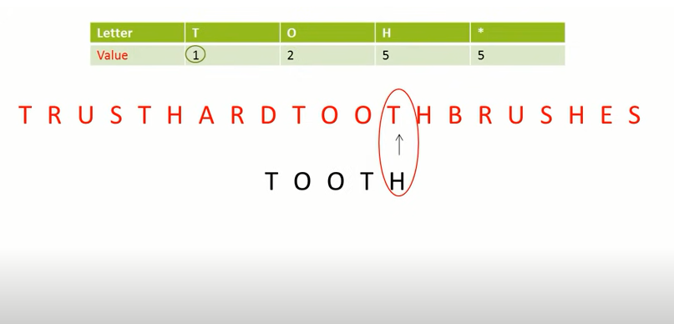

Slide 31
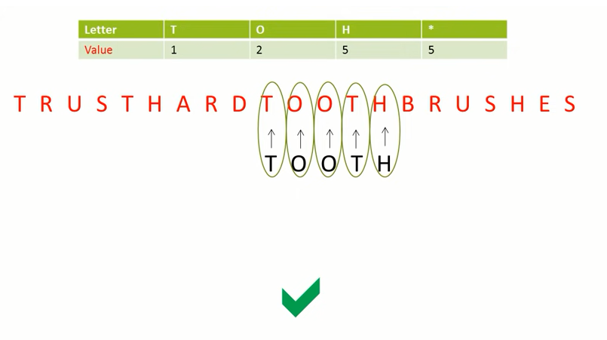

Slide 32
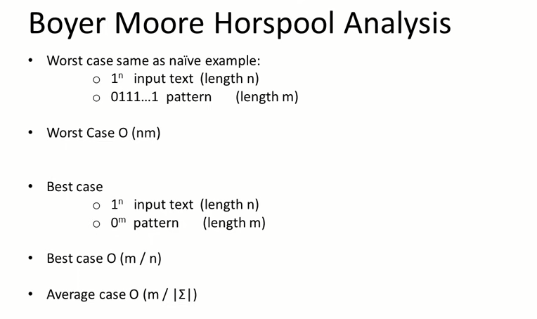

Slide 33
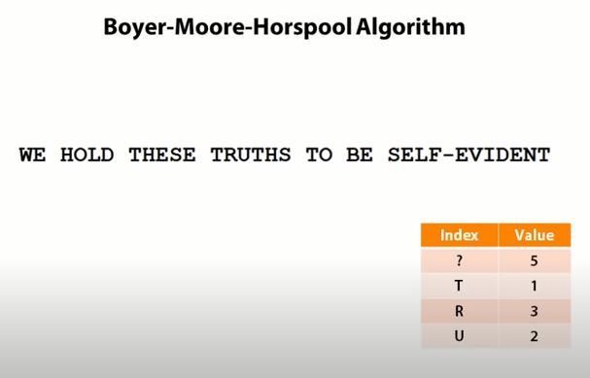

Slide 34
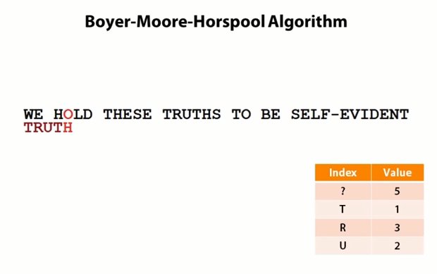

Slide 35
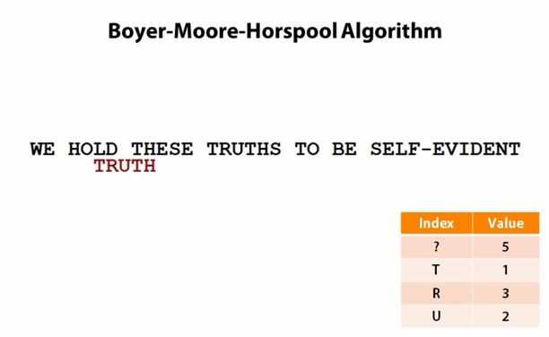

Slide 36
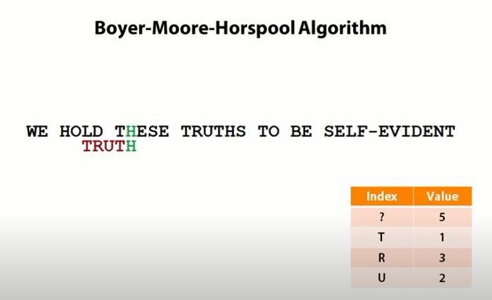

Slide 37
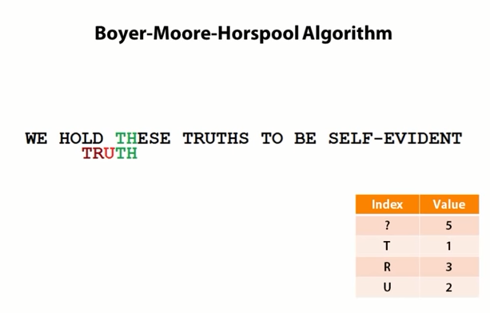

Slide 38
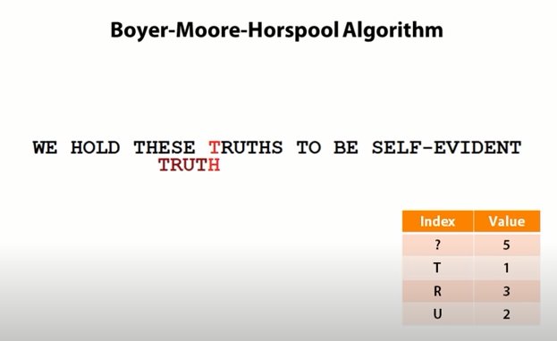

Slide 39
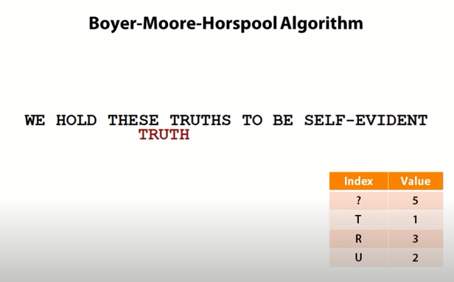

Slide 40
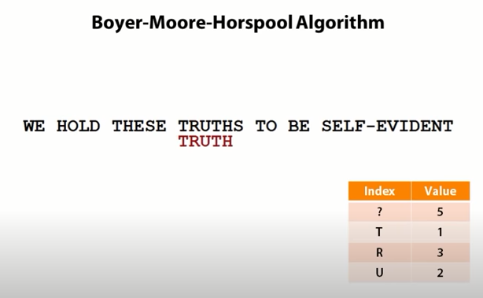

Slide 41
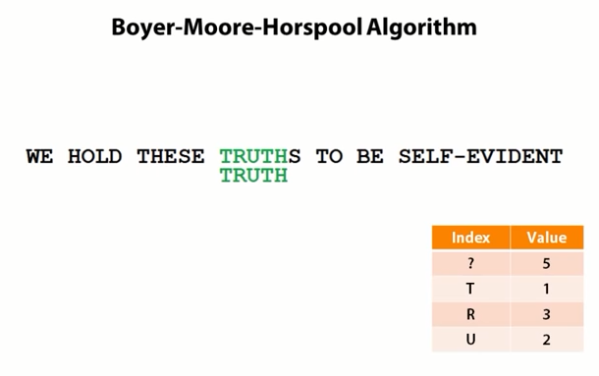

Slide 42
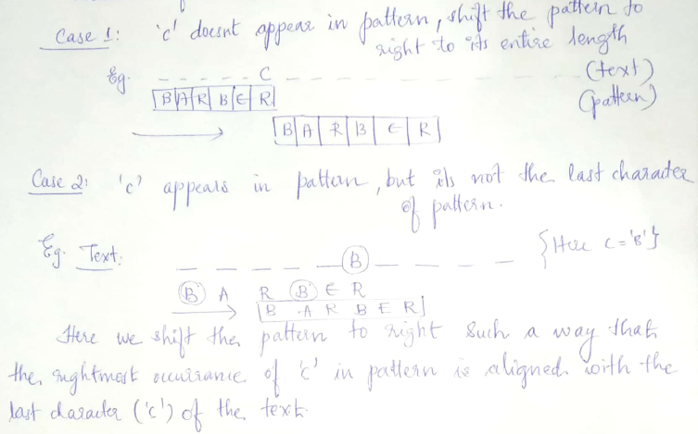
Let c be the character in the text that aligns with the last character of the pattern.
If the pattern does not match there are 4 cases to consider.

Slide 43
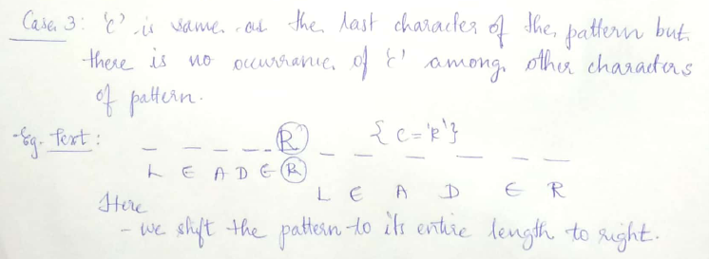
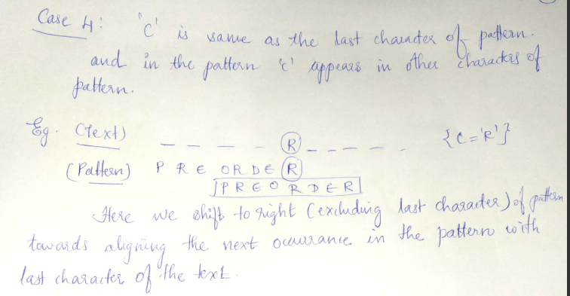

Slide 44
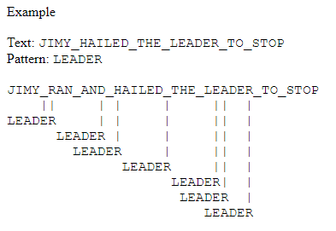
Horspools Algorithm - Example

Slide 45
Complexity

